Slide 1
Contents -
Introduction
Choice of topic
Proposed System
Methodology
Proposed System Model
Proposed Approach
Screenshot
System Requirements
Applications
Advantages & Limitations
Conclusion
Future Scopes
References

Slide 2
Introduction
GiKart is a “one-stop store” of celebrated products having geographical origin (GI Tag). Our customers need not travel to a place to buy its renowned products, we procure, produce and market GI Tag products and adhere to the requirements as mentioned in the Geographical Indications registry. Hence our motto is “from the very land to your hand”. Our categories include- • handicrafts • handlooms • spices• fruits • beverages.
Only Those G.I. products are sold with all sellers being verified by the government certification for G.I. Products .

Slide 3
Choice of topic
Ensured Geographical Indicated Origin.
Unique Qualities from that Origin.
Zero Tolerance to Adulteration.
Product Differentiation
one-stop store

Slide 4
Proposed System
AIM:
It will help the purchase of geographically indicated items.
Proposed System:
Digitalize Shopping of G.I. Products.
G.I. Products With Certification.
Verified Sellers
Shop by category
More Varieties of one product

Slide 5
Methodology
The objective is to create a website that can perform the following:-
Connecting to an HTTPS site through GPRS/WIFI.
Opening the relevant HTML page using HTTPS POST & GET methods.
Read the data logically to a Customer, seller, and admin.
Creating a local database.

Slide 6
Proposed System Model
There are three main modules :
Admin Seller Customer
1. Home 1. Home 1. Home
2. Product Category 2. Product Category 2. All Product
3. Profile 3. Profile 3. View
4. Sellers & Customers 4. Add Products & Banner 4. Profile
5. Orders 5. Products 5. My Orders
6. Log Out 6. Log Out 6. Log Out

Slide 7
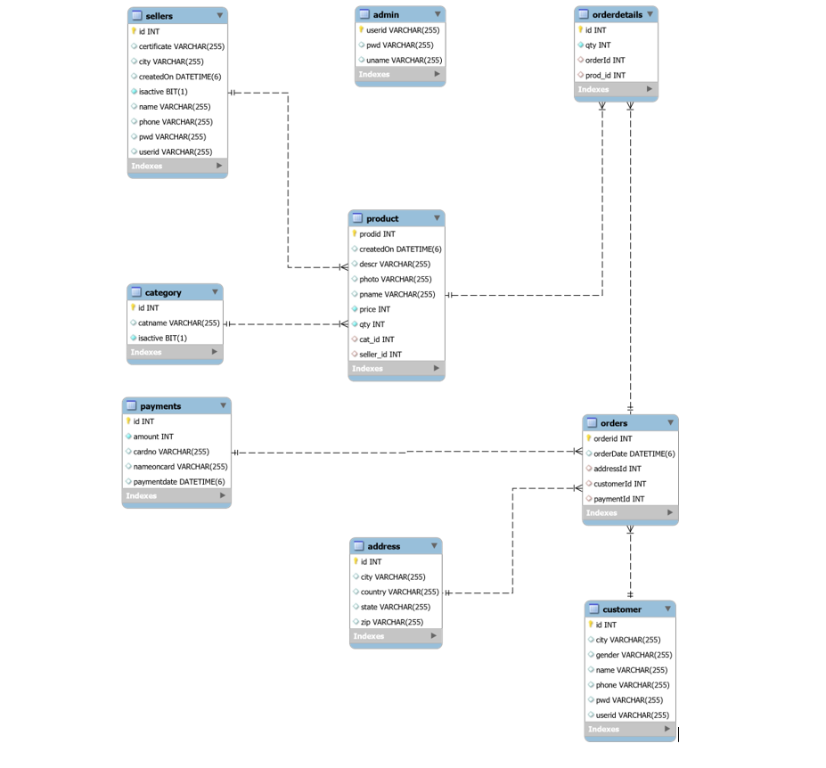
Proposed Approach

Slide 8
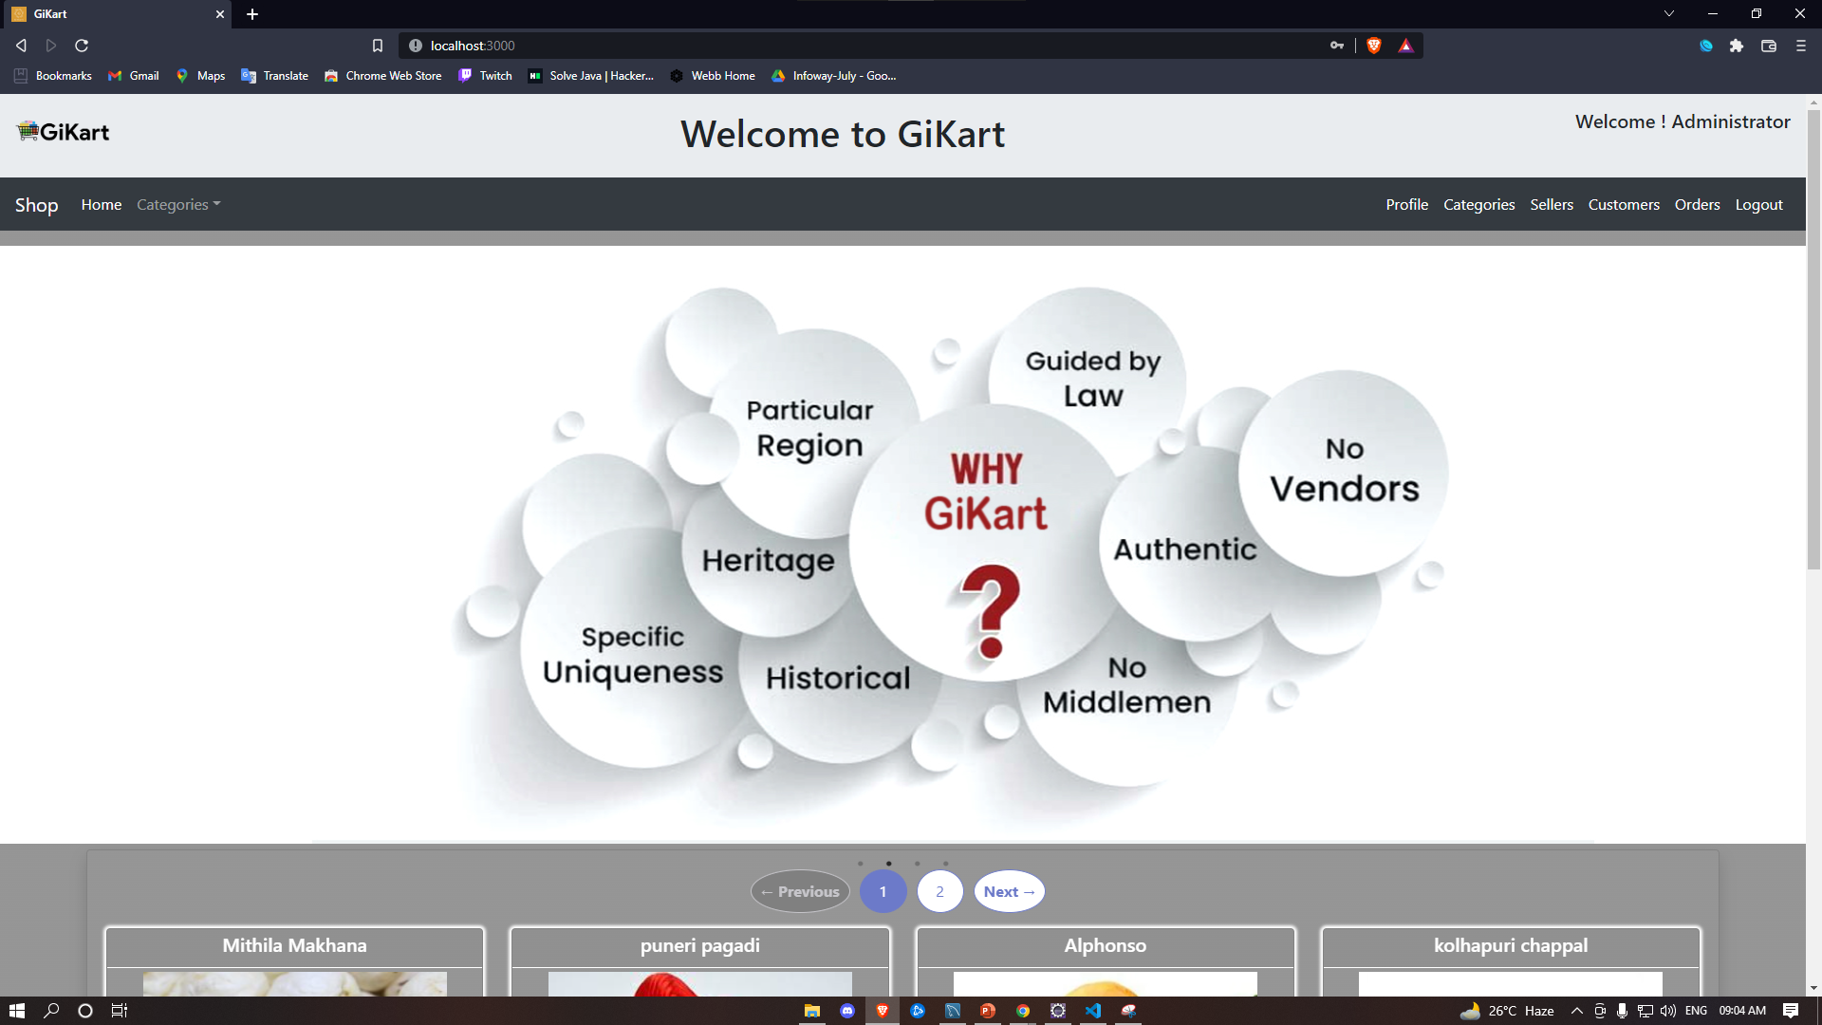
Screenshots

Slide 9
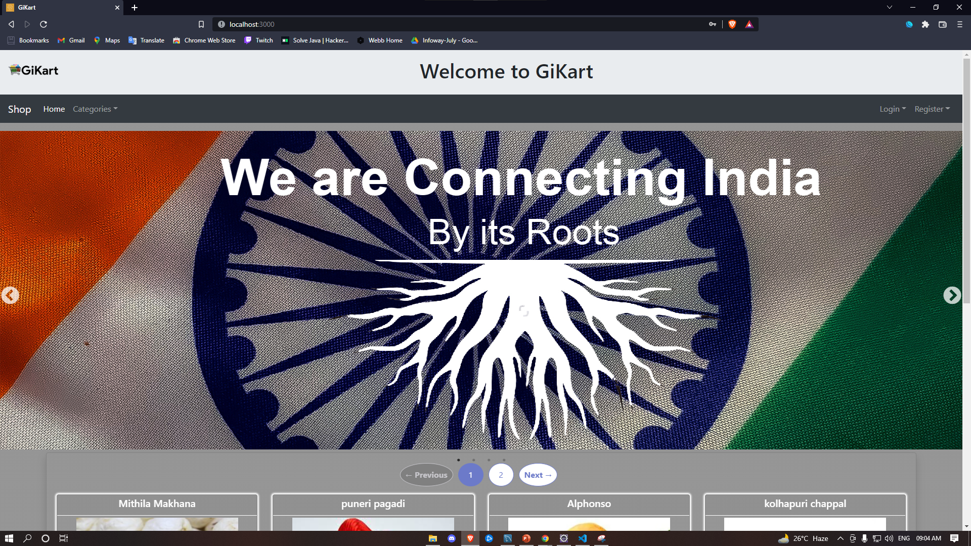

Slide 10
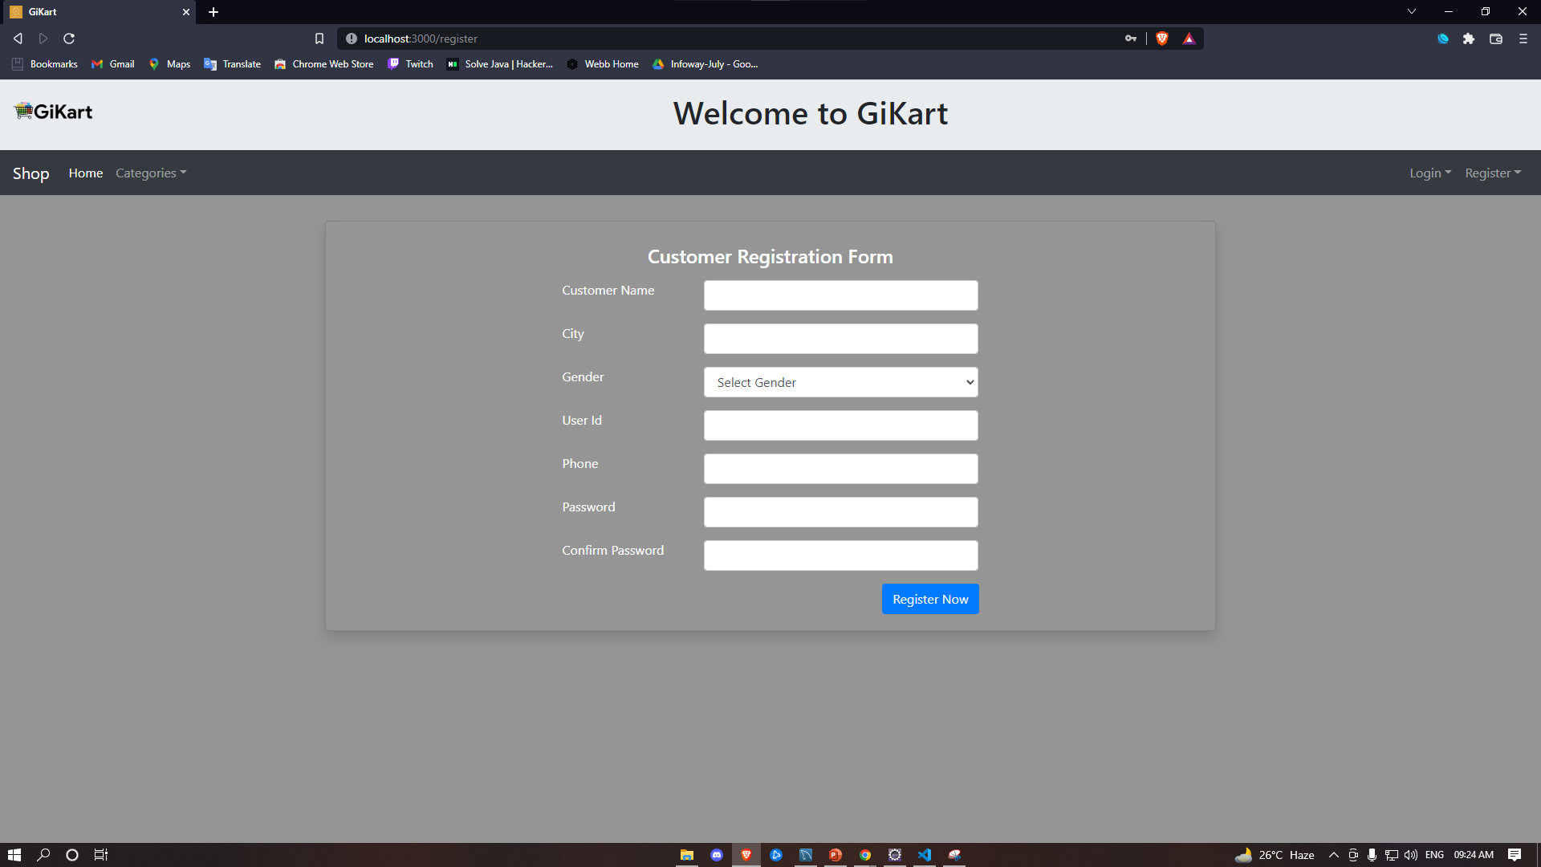

Slide 11
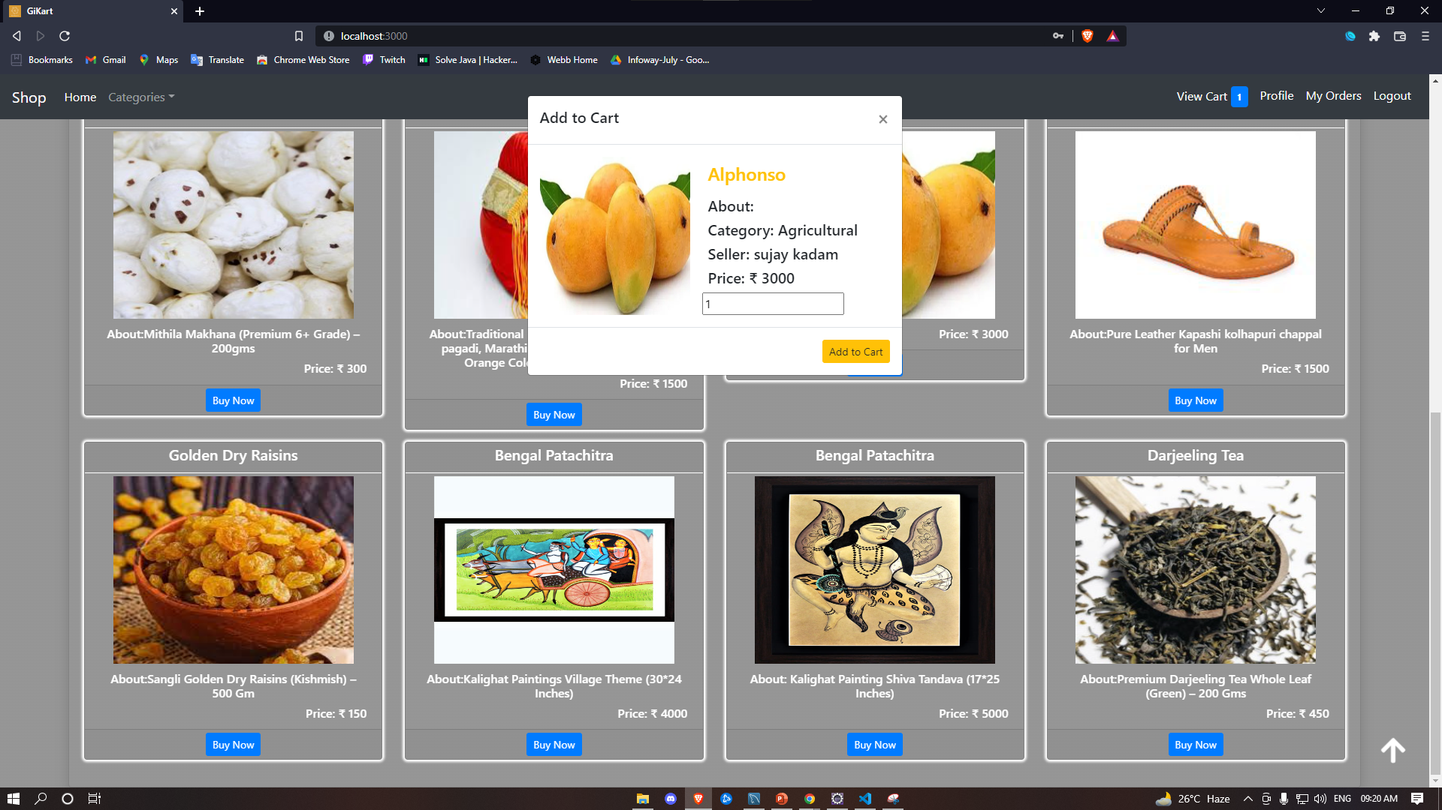

Slide 12
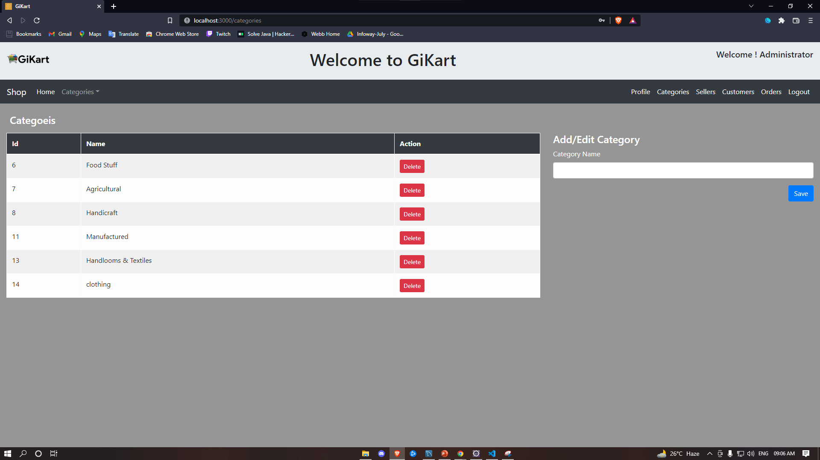

Slide 13
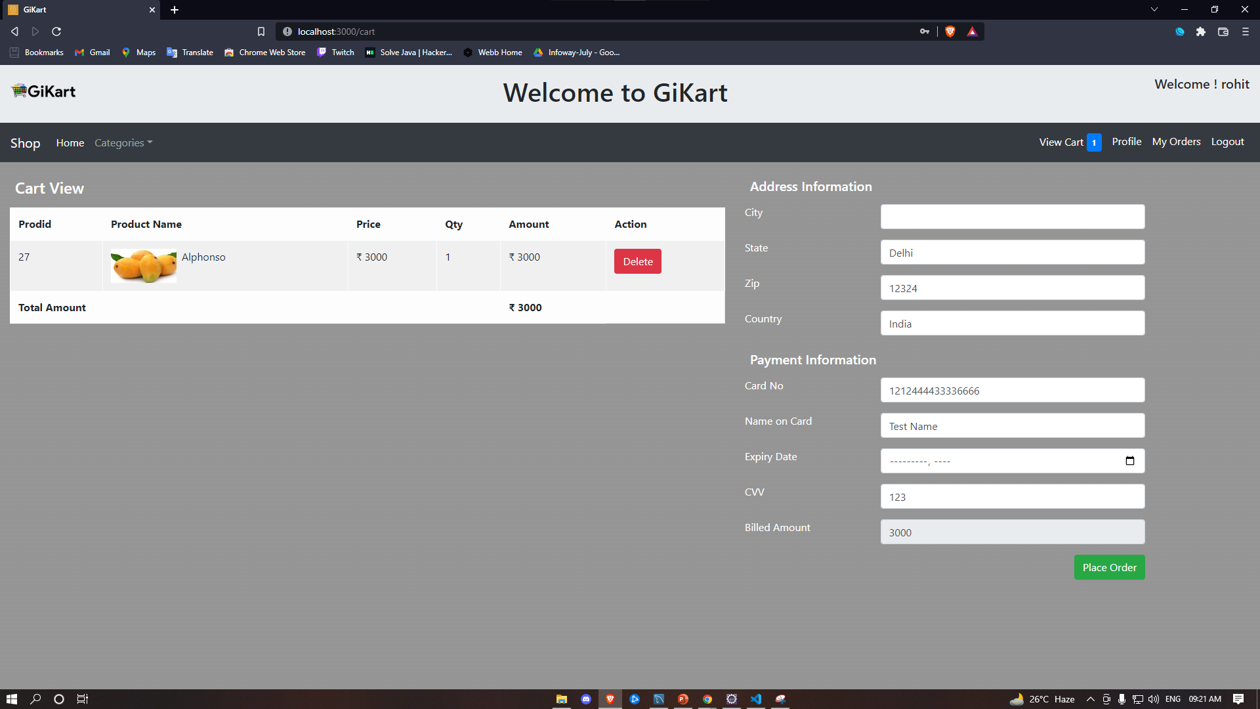

Slide 14
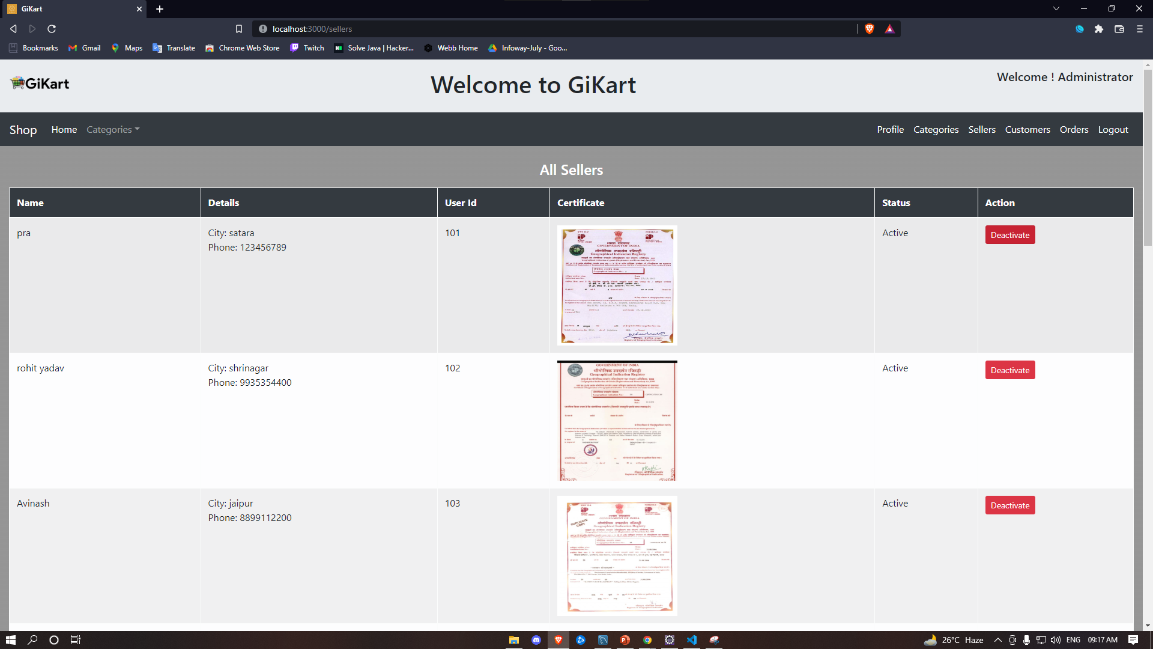

Slide 15
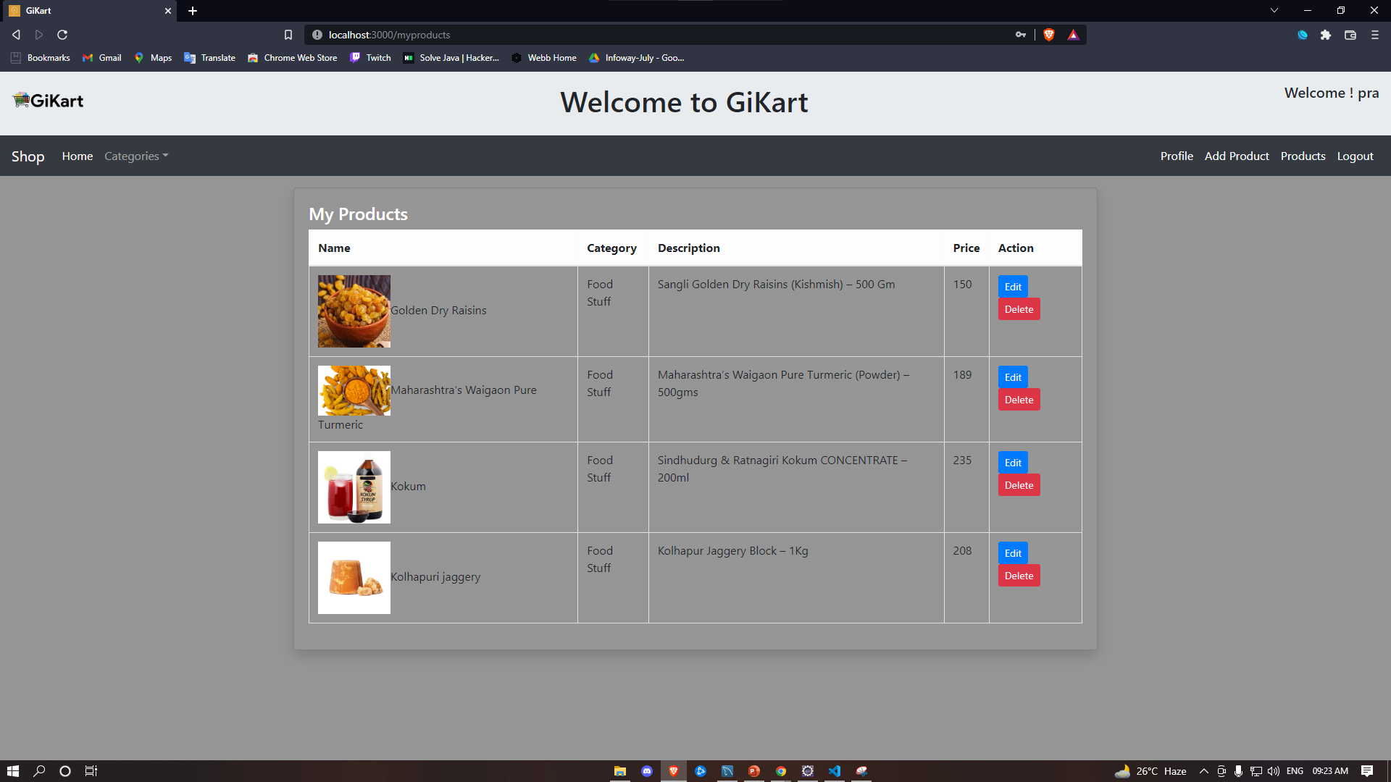

Slide 16


Slide 17
System Requirements
Software Requirements:
• Windows (All Versions)
• Tomcat 8.5
• Eclipse, MySQL, VS Code
2. Hardware Components:
• Processor – i3
• Hard Disk – 5 GB
• Memory – 4GB RAM

Slide 18
Technologies Used
HTML: The page Layout has been designed in HTML.
CSS: Used for all designing parts.
JavaScript: All Validation task and animations has been developed by JS.
React Js: All Frontend Login Written in react js
JAVA: All the business logic has been written in JAVA.
MySQL: MySQL database has been used as a database.
Tomcat: Project will run using the Tomcat server.

Slide 19
Applications
Creating a new business pipeline for farmers, craftsmen & product makers who follow up on their family or regional heritage.
the strengthening of sustainable local food production and supply.
Ensured Geographical Indicated origin products.
Can be used for other countries

Slide 20
Advantages
No Vendor Mechanism
No Middlemen.
Specific Uniqueness.
Guided By Law.
Transparency in the system.
Saves Time, cost, and energy.
Helping Rural And Small Scaled, Businesses.

Slide 21
Limitations
Accurate verification of the users cannot be done online.
Urgent delivery not possible for some food product.
It requires an extensive database and memory.

Slide 22
Conclusion
To create, A Happy Family, A Happy Village & A Strong Rural India, resulting in a vibrant consumer world.
GiKart is India based Company envisioned to Connect all G.I. products of the country by following the mandates as indicated in the GI Registry as per the Geographical Indications of Goods (Registration and Protection) Act 1999. We take pride in our efforts to connect people back to their Roots and at the same time, we make sincere efforts to provide every National with exceptional quality products without any compromise.

Slide 23
Future Scope
Verification of Customer.
Improvement in design.
Mobile Application
UPI payment
Chat BOT
Integration of International G.I. Products.

Slide 24
THANK YOU

